Slide 1

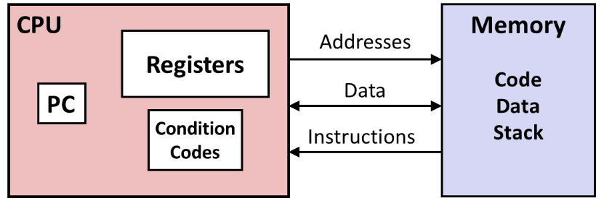
Levels of Abstraction
C code
C programmer
Nice clean layers, but beware…
Assembly programmer

Slide 2
Assembly/Machine Code View
CPU
Memory
Registers
Addresses
Data
Code
Data
Stack
PC
Condition
Codes
Instructions
Programmer-Visible State
PC: Program counter
Address of next instruction
Called “RIP” (x86-64)
Register file
Heavily used program data
Condition codes
Store status information about most recent arithmetic or logical operation
Used for conditional branching
Memory
Byte addressable array
Code and user data
Stack to support procedures

Slide 3
8085 Architecture & Its Assembly language programming

Slide 4
Outline
8085 Era and Features
8085
Block diagram (Data Path)
Bus Structure
Register Structure
Instruction Set of 8085
Sample program of 8085

Slide 5
8085 Microprocessor
8 Bit CPU
3-6Mhz
Simpler design
ISA = Pre x86 design (Semi CISC)
40 Pin Dual line Package
16 bit address
6 registers: B, C, D, E, H,L
Accumulator 8 bit

Slide 6
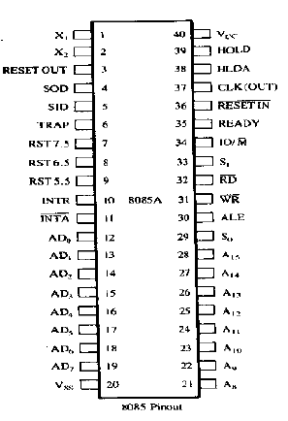
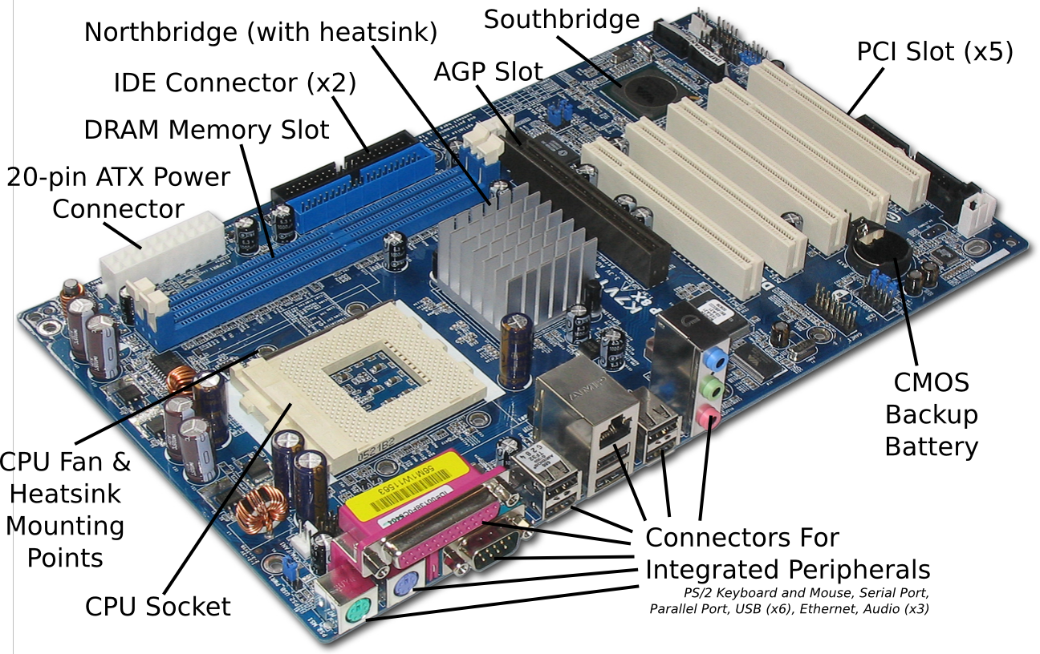
8085-Pin-diagram

Slide 7
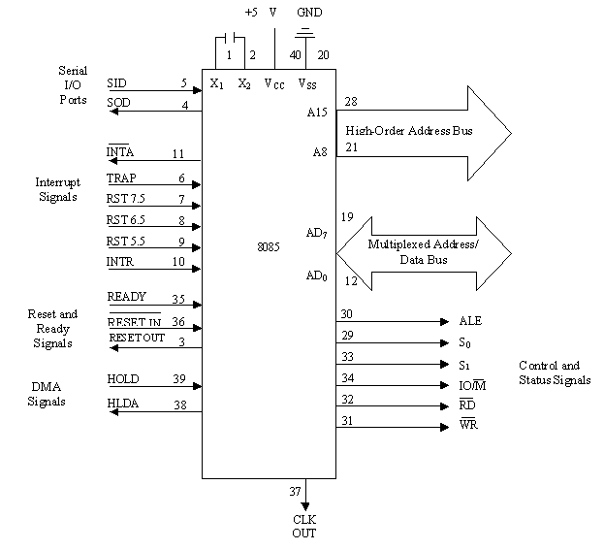
Functional block diagram

Slide 8
8085 Microprocessor Architecture
RST6.5
INTR
INTA
RST5.5
RST7.5
TRAP
SID
SOD
Interrupt Control
Serial I/O Control
Bus 8 Bit
ACC
tmp R
MUX
IR
W
Z
B
C
Flag
D
E
I Decode
&
M/C
Encoding
ALU
H
L
SP
PC
Inc/Dec. ter
Add latch
Timing and Control
Add Buff
Data/Add Buff

Slide 9
The 8085 Bus Structure
8085
MPU
A₁₅
Address Bus (16bit)
A₀
Memory
I/P
O/P
_{D7}
Data Bus (8bit)
_{D0}
Control Bus (8bit)

Slide 10
8085 Bus Structure
Address Bus : Consists of 16 address lines: A₀ – A₁₅
Address locations: 0000 (hex) – FFFF (hex)
Can access 64K ( = 2¹⁶ ) bytes of memory, each byte has 8 bits
Can access 64K × 8 bits of memory
Use memory to map I/O, Same instructions to use for accessing I/O devices and memory
Data Bus : Consists of 8 data lines: D₀ – D₇
Operates in bidirectional mode
The data bits are sent from the MPU to I/O & vice versa
Data range: 00 (hex) – FF (hex)
Control Bus:
Consists of various lines carrying the control signals such as read / write enable, flag bits

Slide 11
8085 Registers
Registers:
Six general purpose 8-bit registers: B, C, D, E, H,L
Combined as register pairs to perform 16-bit operations: BC, DE, HL
Registers are programmable (load, move, etc.)
Stack Pointer (SP)
Accumulator & Flag Register
(Zero, Sign, Carry, Parity, AuxCarry)
Program Counter (PC)
Contains the memory address (16 bits) of the instruction that will be executed in the next step.
B
C
D
E
H
L
SP
PC

Slide 12
Register Addressing
The most common form of data addressing.
once register names learned, easiest to apply.
The microprocessor contains these 8-bit register names used with register addressing: AH, AL, BH, BL, CH, CL, DH, and DL.
16-bit register names: AX, BX, CX, DX, SP, BP, SI, and DI.

Slide 13
In 80386 & above, extended 32-bit register names are: EAX, EBX, ECX, EDX, ESP, EBP, EDI, and ESI.
64-bit mode register names are: RAX, RBX, RCX, RDX, RSP, RBP, RDI, RSI, and R8 through R15.
Important for instructions to use registers that are the same size.
never mix an 8-bit with a 16-bit register, an 8- or a 16-bit register with a 32-bit register
this is not allowed by the microprocessor and results in an error when assembled

Slide 14
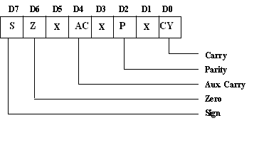
Flag Register

Slide 15
Status Signals
IO/M | S1 | S0 | OPERATION
0 | 1 | 1 | Opcode fetch
0 | 1 | 0 | Memory read
0 | 0 | 1 | Memory write
1 | 1 | 0 | I/O read
1 | 0 | 1 | I/O write
1 | 1 | 0 | Interrupt acknowledge
Z | 0 | 1 | Halt
Z | x | x | Hold
Z | x | x | Reset

Slide 16
Reset Signal
RESET IN : When this signal goes low,
the program counter (PC) is set to Zero,
μp is reset
The data and address buses and the control lines are 3-stated during RESET
The CPU is held in the reset condition as long as RESET- IN is applied
RESET OUT: This signal indicates that μp is being reset.
This signal can be used to reset other devices.
The signal is synchronized to the processor clock and lasts an integral number of clock periods.
.

Slide 17
Serial communication
Serial communication Signal
SID - Serial Input Data Line: The data on this line is loaded into accumulator bit 7 whenever a RIM instruction is executed.
SOD – Serial Output Data Line: The SIM instruction loads the value of bit 7 of the accumulator into SOD latch if bit 6 (SOE) of the accumulator is 1.

Slide 18
DMA Signals
HOLD: Indicates that another master is requesting the use of the address and data buses.
The CPU, upon receiving the hold request, will relinquish the use of the bus as soon as the completion of the current bus transfer.
Internal processing can continue. The processor can regain the bus only after the HOLD is removed.
When the HOLD is acknowledged, the Address, Data RD, WR and IO/M lines are 3-stated.
HLDA: Hold Acknowledge: Indicates that the CPU has received the HOLD request and that it will relinquish the bus in the next clock cycle.
HLDA goes low after the Hold request is removed. The CPU takes the bus one half-clock cycle after HLDA goes low.

Slide 19
Ready Signal
READY: This signal Synchronizes the fast CPU and the slow memory, peripherals.
If READY is high during a read or write cycle, it indicates that the memory or peripheral is ready to send or receive data.
If READY is low, the CPU will wait an integral number of clock cycle for READY to go high before completing the read or write cycle.
READY must conform to specified setup and hold times.

Slide 20
Interrupts
8085 has 5 interrupts priority (from lowest to highest):
INTR: (maskable and non-vectored interrupt). When the interrupt occurs, the processor fetches from the bus one instruction, usually one of these instructions:
One of the 8 RST instructions (RST0 - RST7). The processor saves current program counter into stack and branches to memory location N * 8 (where N is a 3-bit number from 0 to 7 supplied with the RST instruction).
CALL: (3 byte instruction). The processor calls the subroutine, address of which is specified in the second and third bytes of the instruction.
RST5.5: (maskable interrupt). When this interrupt is received the processor saves the contents of the PC register into stack and branches to 2CH address.
RST6.5: (maskable interrupt) When this interrupt is received the processor saves the contents of the PC register into stack and branches to 34H address
RST7.5 (maskable interrupt) When this interrupt is received the processor saves the contents of the PC register into stack and branches to 3CH (hexadecimal) address
TRAP: (non-maskable interrupt) When this interrupt is received the processor saves the contents of the PC register into stack and branches to 24H address.
All maskable interrupts can be enabled or disabled using EI and DI instructions. RST 5.5, RST6.5 and RST7.5 interrupts can be enabled or disabled individually using SIM instruction
Notes:
INTR is maskable using the EI/DI instruction pair
The vectors for these interrupt fall in between the
vectors for the RST instructions. That’s why they
have names like RST 5.5 (RST 5 and a half)

Slide 21
8085 Non-Vectored Interrupt Process
The interrupt process should be enabled using the EI instruction.
The 8085 checks for an interrupt during the execution of every instruction.
If INTR is high, Processor completes current instruction, disables the interrupt and sends INTA (Interrupt acknowledge) signal to the device that interrupted
INTA allows the I/O device to send a RST instruction through data bus.
MP saves the memory location of the next instruction, on the stack and the program is transferred to ‘call’ location (ISR Call) specified by the RST instruction
Microprocessor Performs the ISR. ISR must include the ‘EI’ instruction to enable the further interrupt within the program.
RET instruction at the end of the ISR allows the MP to retrieve the return address from the stack and the program is transferred back to where the program was interrupted.

Slide 22
Interrupt vectors
An interrupt vector is a pointer to where the ISR is stored in memory.
All interrupts (vectored or otherwise) are mapped onto a memory area called the Interrupt Vector Table(IVT).
The IVT is usually located in memory page 00 (0000H - 00FFH).
Example:
Let a device interrupts the Microprocessor using the RST 7.5 interrupt line.
Because the RST 7.5 interrupt is vectored, Microprocessor knows in which memory location it has to go using a call instruction to get the ISR address.
RST7.5 is known as Call 003Ch to Microprocessor. Microprocessor goes to 003C location and will get a JMP instruction to the actual ISR address. The microprocessor will then, jump to the ISR location

Slide 23
Vectored Interrupt
The interrupt process should be enabled using the EI instruction.
The 8085 checks for an interrupt during the execution of every instruction.
If there is an interrupt, and if the interrupt is enabled using the interrupt mask, the microprocessor will complete the executing instruction, and reset the interrupt flip flop.
The microprocessor then executes a call instruction that sends the execution to the appropriate location in the interrupt vector table.
When the microprocessor executes the call instruction, it saves the address of the next instruction on the stack.
The microprocessor jumps to the specific service routine.
The service routine must include the instruction EI to re-enable the interrupt process.
At the end of the service routine, the RET instruction returns the execution to where the program was interrupted.

Slide 24
MANIPULATING THE MASKS
MANIPULATING THE MASKS
The Interrupt Enable flip flop is manipulated using the EI/DI instructions.
The individual masks for RST 5.5, RST 6.5 and RST 7.5 are manipulated using the SIM instruction.
The SIM instruction takes the bit pattern in the Accumulator and applies it to the interrupt mask enabling and disabling the specific interrupts.

Slide 25
How SIM Interprets the Accumulator
7
6
5
4
3
2
1
0
M7.5
M5.5
SDO
MSE
M6.5
SDE
R7.5
XXX
RST5.5 Mask
}
Serial Data Out
RST6.5 Mask
0 - Available
1 - Masked
RST7.5 Mask
Enable Serial Data
0 - Ignore bit 7
1 - Send bit 7 to SOD pin
Mask Set Enable
0 - Ignore bits 0-2
1 - Set the masks according
to bits 0-2
Not Used
Force RST7.5 Flip Flop to reset
If MSE is 1
If the mask bit is 0, the interrupt is available.
If the mask bit is 1, the interrupt is masked.

Slide 26
How RIM sets the Accumulator’s different bits
7
6
5
4
3
2
1
0
M7.5
M5.5
SDI
P6.5
IE
M6.5
P7.5
P5.5
RST5.5 Mask
}
Serial Data In
RST6.5 Mask
0 - Available
1 - Masked
RST7.5 Mask
RST5.5 Interrupt Pending
RST6.5 Interrupt Pending
RST7.5 Interrupt Pending
Interrupt Enable
Value of the Interrupt Enable
Flip Flop

Slide 27
Determining the Current Mask Settings
RIM instruction: Read Interrupt Mask
Load the accumulator with an 8-bit pattern showing the status of each interrupt pin and mask.
RST7.5 Memory
RST 7.5
M 7.5
7
6
5
4
3
2
1
0
SDI
M7.5
M5.5
P7.5
IE
M6.5
P6.5
P5.5
RST 6.5
M 6.5
RST 5.5
M 5.5
Interrupt Enable
Flip Flop

Slide 28
What is Memory Mapped I/O?
Instead of having special methods for accessing the values to be read or written, just get them from memory or put them into memory.
The device is connected directly to certain main memory locations.
Two types of information to/from the device
Status
Value read/write

Slide 29
Memory Mapped I/O
CPU
Address
Data
7
0
Main memory
Data register
(address = 5000)
7
0
Ready
IF
…
IE
Status register
(address = 5002)
Keyboard controller

Slide 30
Mother Board

Slide 31
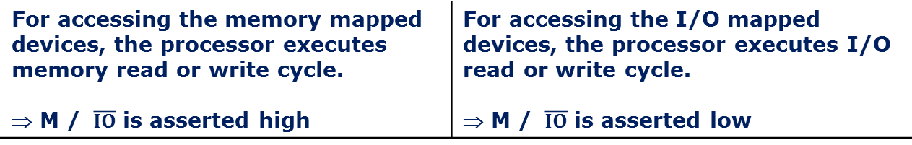
comparison
Memory mapping | I/O mapping
16/20 bit address are provided for I/O devices | 8-bit or 16-bit addresses are provided for I/O devices
The I/O ports or peripherals can be treated like memory locations and so all instructions related to memory can be used for data transmission between I/O device and processor | Only IN and OUT instructions can be used for data transfer between I/O device and processor
Data can be moved from any register to ports and vice versa | Data transfer takes place only between accumulator and ports
When memory mapping is used for I/O devices, full memory address space cannot be used for addressing memory. ⇒ Useful only for small systems where memory requirement is less | Full memory space can be used for addressing memory. ⇒ Suitable for systems which require large memory capacity
For accessing the memory mapped devices, the processor executes memory read or write cycle. ⇒ M / $\overline{IO}$ is asserted high | For accessing the I/O mapped devices, the processor executes I/O read or write cycle. ⇒ M / $\overline{IO}$ is asserted low

Slide 32
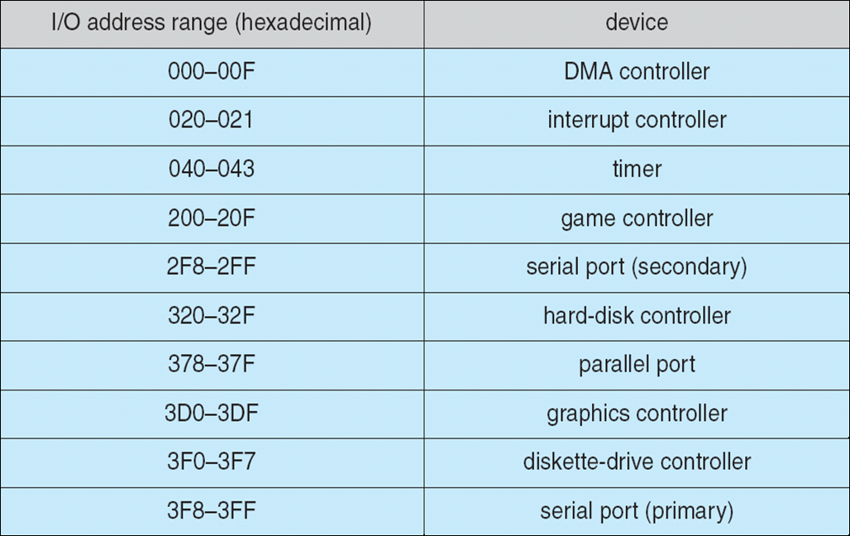
IO Mapped IO Device I/O Port Locations on PCs (partial)

Slide 33
Instruction format
Based on word size(8-bit processor so byte is same as word)
One byte instruction
Ex.: Mov rd,rs
Binary code: 01 ddd sss
Mov A,B: 01 111 000 = 78h
Two byte instruction
Ex.: mvi A, data
Binary code: 0011 1110 data
Mvi A, 30: 3E 30h
Three byte instruction
Ex.: Lxi rp,data_address //rp: register pair
Binary code: 21 lower_byte upper byte address
Lxi H, 2236: 21 36 22 h

Slide 34
MACHINE CYCLE
The 8085 CPU can perform seven basic machine operations. All but the bus-idle cycle involve the transfer of data between the CPU and a peripheral device.
The seven machine cycles are :
Opcode Fetch fetch the opcode of an instruction from memory
Memory Read read data stored at an addressed memory location
Memory Write write data to an addressed memory location
IO Read read data from an addressed input device
IO Write write data to an addressed output device
Interrupt Ack acknowledge an interrupt request
Bus Idle no bus operation

Slide 35
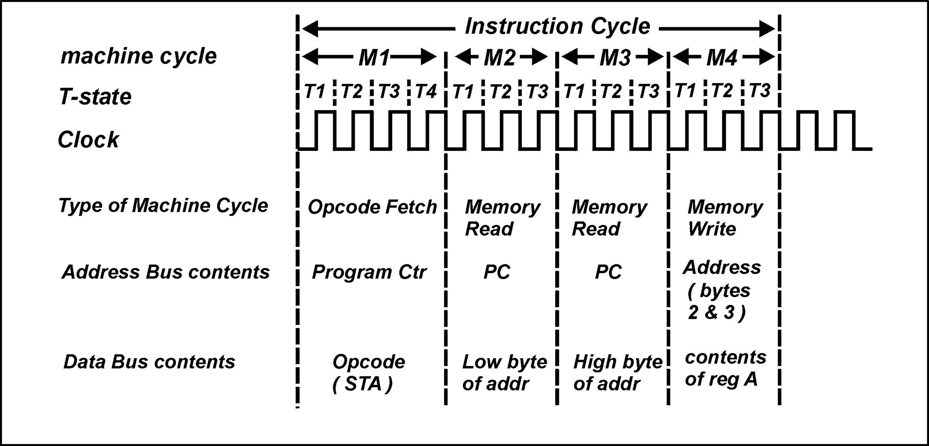
MACHINE CYCLE
Example instruction: STA addr

Slide 36
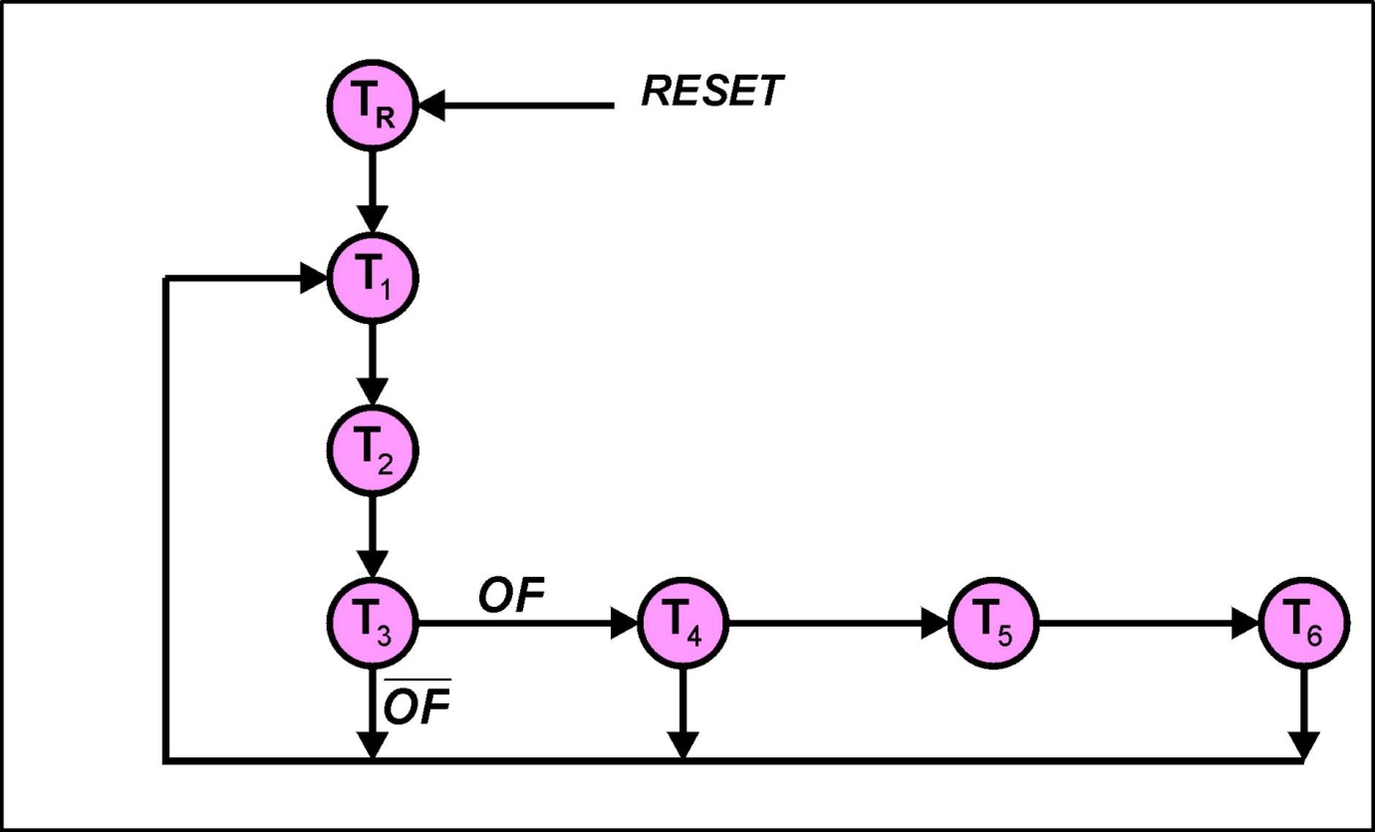
T-STATE
The operation of the 8085 can be described with respect to its state diagram ( it is a synchronous state machine )

Slide 37
MACHINE CYCLE
Opcode Fetch
The first operation in every instruction
Retrieves the opcode of the instruction that is being executed
Usually composed 4 clock cycles (T-state)
Some instruction required 6 T-state (CALL, INX, DCX)
IO/M signal is low (indicating a memory operation)

Slide 38
MACHINE CYCLE
Memory Read
Machine cycle during which memory is read
Composed 3 clock cycles
IO/M signal is low (indicating a memory operation)
Memory Write
This machine cycle is used when the 8085 needs to send data out from the accumulator or a specific register and then write it into memory
Composed 3 clock cycles
IO/M signal is low (indicating a memory operation)

Slide 39
MACHINE CYCLE
I/O Read
Indicates that data is being read from an I/O device
Occurs when IN instruction is executed
Composed 3 clock cycles
IO/M signal is high (indicating an I/O operation)
I/O Write
This machine cycle is used to write data out from accumulator in the microprocessor to the I/O device specified by the port address
Occurs when OUT instruction is executed
Composed 3 clock cycles
IO/M signal is high (indicating an I/O operation)

Slide 40
MACHINE CYCLE
Interrupt Acknowledge
Special machine cycle that is used to place of the opcode fetch cycle in the RST (restart) instruction.
Similar to opcode fecth instruction except that it send out INTA signal instead of RD signal and IO/M signal is High
Composed 6 clock cycle

Slide 41
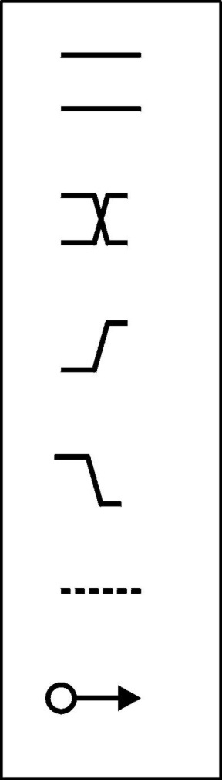
T-STATE
Key to timing diagram
Indicates a bus. Whilst the lines remain parallel the
individual bits of the bus remain unchanged.
Indicates a bus. Where the lines cross indicates a possible change in logic level of one or more bits of the bus.
Indicates a 0 -> 1 transition of a digital signal
Indicates a 1 -> 0 transition of a digital signal
Indicates a bus or a bit being in the Hi-Z state ( tri-state )
The tail of the arrow indicates the cause of a signal change.
The head of the arrow indicates the affected signal.

Slide 42
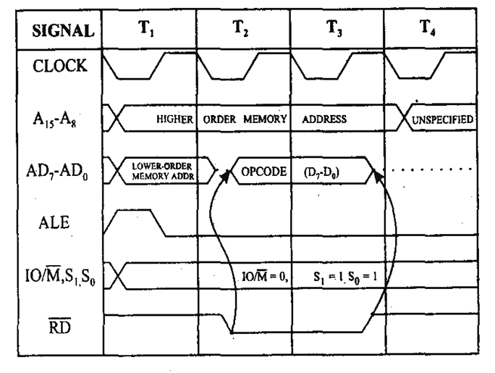
Opcode Fetch

Slide 43
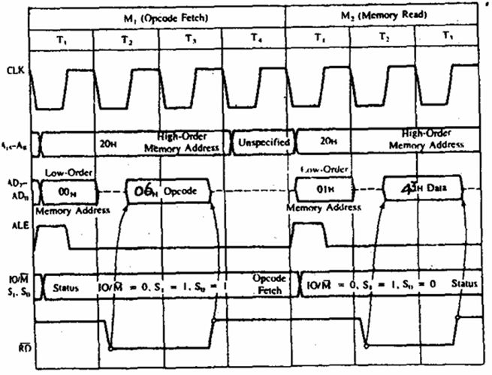
MVI

Slide 44
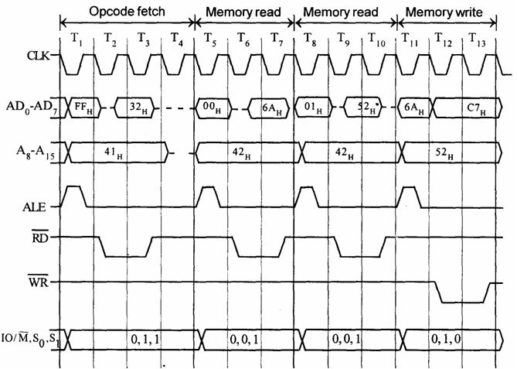
STA 526A (32, 6A, 52 ( ACC-C7)

Slide 45
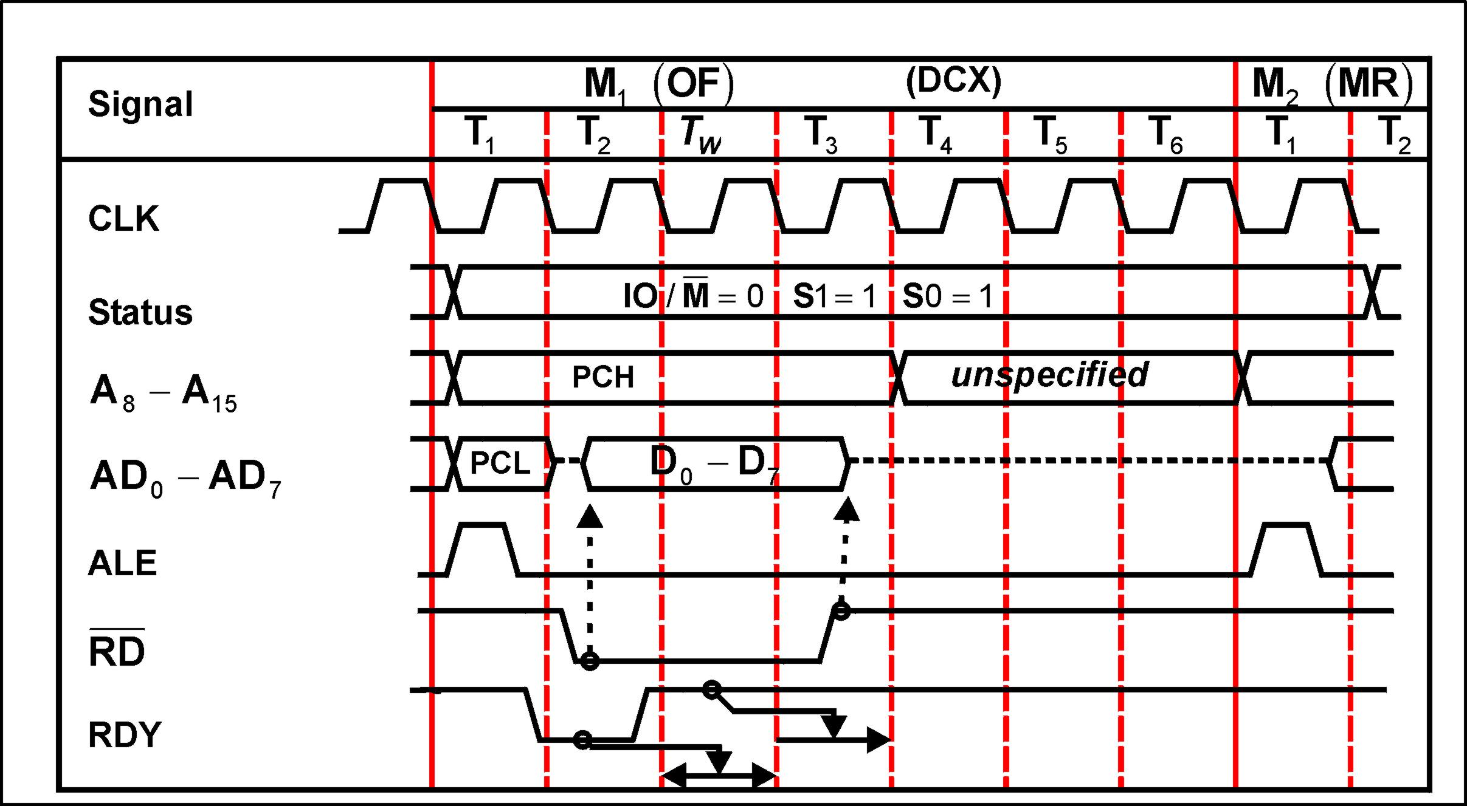
Wait-State

Slide 46
Instruction Set & Addressing mode
Instruction Set:
8085 instruction set consists of the following instructions:
Data moving instructions.
Arithmetic - add, subtract, increment and decrement.
Logic - AND, OR, XOR and rotate.
Control transfer - conditional, unconditional, call subroutine, return from subroutine and restarts.
Input/Output instructions.
Other - setting/clearing flag bits, enabling/disabling interrupts, stack operations, etc.
Addressing mode
Register - references the data in a register or in a register pair.
Register indirect - instruction specifies register pair containing address, where the data is located.
Direct,
Immediate - 8 or 16-bit data

Slide 47
8085 Microprocessor Memory
Memory:
Program, data and stack memories occupy the same memory space. The total addressable memory size is 64KB.
Program memory - program can be located anywhere in memory.
Jump, branch and call instructions use 16-bit addresses, i.e. they can be used to jump/branch anywhere within 64 KB.
All jump/ branch instructions use absolute addressing.
Data memory - the processor always uses 16-bit addresses so that data can be placed anywhere.
Stack memory is limited only by the size of memory. Stack grows downward.
First 64 bytes in a zero memory page should be reserved for vectors used by RST instructions
Notes:
First 64 bytes in a zero memory page should be reserved for vectors used by RST instructions

Slide 48
8085 MP Instruction Set Architecture
Contains several registers include B,C,D,E,H,L and an 8-bit accumulator register, A.
The registers B,C,D,E,H,L can be accessed as pairs. Pairs are not arbitrary. B and C, D and E, H and L.
SP is a 16 bit stack pointer register pointing to the top of the stack.
PC is a 16-bit Program counter
Contains five flags known as flag registers:
Notes:
Parity flag, P, is set to 1 if result contains even number of 1’s
Auxiliary carry flag, generates a carry out from a lower half of a result to a upper half.
Example:
0000 1111 + 0000 1000 = 0001 0111

Slide 49
Instruction Set of 8085
Arithmetic Operations
add, sub, inr/dcr
Logical operation
and, or, xor, rotate, compare, complement
Branch operation
Jump, call, return
Data transfer/Copy/Memory operation/IO
MOV, MVI, LD, ST, OUT

Slide 50
Copy/Mem/IO operation
MVI R, 8 bit // load immediate data
MOV R1, R2 // Example MOV B, A
MOV R M // Copy to R from 0(HL Reg) Mem
MOV M R // Copy from R to 0(HL Reg) Mem
LDA 16 bit // load A from 0(16bit)
STA 16 bit // Store A to 0(16bit)
LDAX Rp // load A from 0(Rp), Rp=RegPair
STAX Rp // Store A to 0(Rp)
LXI Rp 16bit // load immediate to Rp
IN 8bit // Accept data to A from port 0(8bit)
OUT 8 bit // Send data of A to port 0(8bit)

Slide 51
Arithmetic Operation
ADD R // Add A = A + B.reg
ADI 8bit // Add A= A + 8bit
ADD M // Add A=A + 0(HL)
SUB R // Sub A = A -B.reg
SUI 8bit // Sub A= A - 8bit
SUB M // Sub A=A - 0(HL)
INR R // R = R+1
INR M // 0(HL)=0(HL)+1
DCR R // R = R-1
DCR M // 0(HL)=0(HL)-1
INX Rp // Rp=Rp+1
DCX Rp // Rp=Rp-1

Slide 52
Other Operations
Logic operations
ANA R ANI 8bit ANA M
ORA, ORI, XRA, XRI
CMP R // compare with R with ACC
CPI 8bit // compare 8 bit with ACC
Branch operations
JMP 16bit, CALL 16 bit
JZ 16bit, JNZ 16bit, JC 16bit, JNC 16 bit
RET
Machine Control operations
HLT, NOP, POP, PUSH

Slide 53
8085 Microprocessor Instruction Set
Contains a total of 74 different instructions.
R, R1, R2 | 8 bit registers representing A, B, C, D, E, H or L
M | Indicates memory location
RP | Indicates register pair such as BC, DE, HL, SP
Γ | 16 bit address representing address or data value.
n | 8-bit address or data value stored in memory immediately after the opcode
Cond | Condition for conditional instructions. NZ (Z = 0), Z (Z = 1),P (S = 0), N (S = 1), PO (P = 0), PE (P = 1), NC (CY = 0), C (CY=1)

Slide 54
Data movement instruction for the 8085 microprocessor
Instruction | Operation
NOP | No operation
MOV r1, r2 | r1 = r2
MOV r, M | r1 = M[HL]
MOV M, r | M[HL] = r
MVI r, n | r = n
MVI M, n | M[HL] = n
LXI rp, Γ | rp = Γ
LDA Γ | A = M[Γ]
STA Γ | M[Γ] = A
LHLD Γ | HL = M[Γ], M[Γ + 1]
SHLD Γ | M[Γ], M[Γ + 1] = HL
LDAX rp | A = M[rp] (rp = BC, DE)
STAX rp | M[rp] = A (rp = BC, DE)
XCHG | DE ↔ HL
PUSH rp | Stack = rp (rp ≠ SP)
PUSH PSW | Stack = A, flag register
POP rp | rp = Stack (rp ≠ SP)
POP PSW | A, flag register = Stack
XTHL | HL ↔ Stack
SPHL | SP = HL
IN n | A = input port n
OUT n | Output port n = A

Slide 55
Data operation instruction for the 8085 microprocessor
Instruction | Operation | Flags
ADD r | A = A + r | All
ADD M | A = A + M[HL] | All
ADI n | A = A + n | All
ADC r | A = A + r + CY | All
ADC M | A = A + M[HL] + CY | All
ACI n | A = A + n + CY | All
SUB r | A = A - r | All
SUB M | A = A - M[HL] | All
SUI n | A = A - n | All
SBB r | A = A - r - CY | All
SBB M | A = A - M[HL] - CY | All
SBI n | A = A - n - CY | All
INR r | r = r + 1 | Not CY
INR M | M[HL] = M[HL] + 1 | Not CY
DCR r | r = r - 1 | Not CY
DCR M | M[HL] = M[HL] - 1 | Not CY
INX rp | rp = rp + 1 | None
DCX rp | rp = rp - 1 | None
DAD rp | HL = HL + rp | CY
DAA | Decimal adjust | All
ANA r | A = A ∧ r | All
ANA M | A = A ∧ M[HL] | All

Slide 56
Data operation instruction for the 8085 microprocessor
Instruction | Operation | Flags
ANI n | A = A ∧ n | All
ORA r | A = A ∨ r | All
ORA M | A = A ∨ M[HL] | All
ORI n | A = A ∨ n | All
XRA r | A = A ⊕ r | All
XRA M | A = A ⊕ M[HL] | All
XRI n | A = A ⊕ n | All
CMP r | Compare A and r | All
CMP M | Compare A and M[HL] | All
CPI n | Compare A and n | All
RLC | CY = A7, A = A(6-0), A7 | CY
RRC | CY = A0, A = A0, A(7-1) | CY
RAL | CY, A = A, CY | CY
RAR | A, CY = CY, A | CY
CMA | A = A’ | None
CMC | CY = CY’ | CY
STC | CY = 1 | CY

Slide 57
Program control instruction
Instruction | Operation
JUMP Γ | GOTO Γ
J cond Γ | If condition is true then GOTO Γ
PCHL | GOTO address HL
CALL Γ | Call subroutine at Γ
C cond Γ | If condition is true then call subroutine at Γ
RET | Return from subroutine
R cond | If condition is true then return from subroutine
RST n | Call subroutine at 8*n (n = 5.5, 6.5, 7.5)
RIM | A = IM
SIM | IM = A
DI | Disable interrupts
EI | Enable interrupts
HLT | Halt the CPU

Slide 58
A Simple 8085 Program
1: i = n, sum = 0
2: sum = sum + i, i = i - 1
3: IF i ≠ 0 then GOTO 2
4: total = sum

Slide 59
A Simple 8085 Program (contd)
LDA n
MOV B, A
XRA A
Loop: ADD B
DCR B
JNZ Loop
STA total
i = n
sum = A ⊕ A = 0
sum = sum + i
i = i - 1
IF i ≠ 0 THEN GOTO Loop
total = sum

Slide 60
Execution trace
Instruction | 1st Loop | 2nd Loop | 3rd Loop | 4th Loop | 5th Loop
LDA n MOV B, A | B = 5
XRA A | A = 0
ADD B | A = 5 | A = 9 | A = 12 | A = 14 | A = 15
DCR B | B = 4, Z = 0 | B = 3, Z = 0 | B = 2, Z = 0 | B = 1, Z = 0 | B = 0, Z = 1
JNZ Loop | JUMP | JUMP | JUMP | JUMP | NO JUMP
STA total |  |  |  |  | total = 15

Slide 61
Simple Assembly Program
MVI A, 24H // load Reg ACC with 24H
MVI B , 56H // load Reg B with 56H
ADD B // ACC= ACC+B
OUT 01H // Display ACC contents on port 01H
HALT // End the program
Result: 7A (All are in Hex)

Slide 62
Code to multiply two number
LDA 2000 // Load multiplicant to accumulator
MOV B,A // Move multiplicant from A(acc) to B register
LDA 2001 // Load multiplier to accumulator
MOV C,A // Move multiplier from A to C
MVI A,00 // Load immediate value 00 to a
L: ADD B // Add B(multiplier) with A
DCR C // Decrement C, it act as a counter
JNZ L // Jump to L if C reaches 0
STA 2010 // Store result in to memory
HLT // End

Slide 63
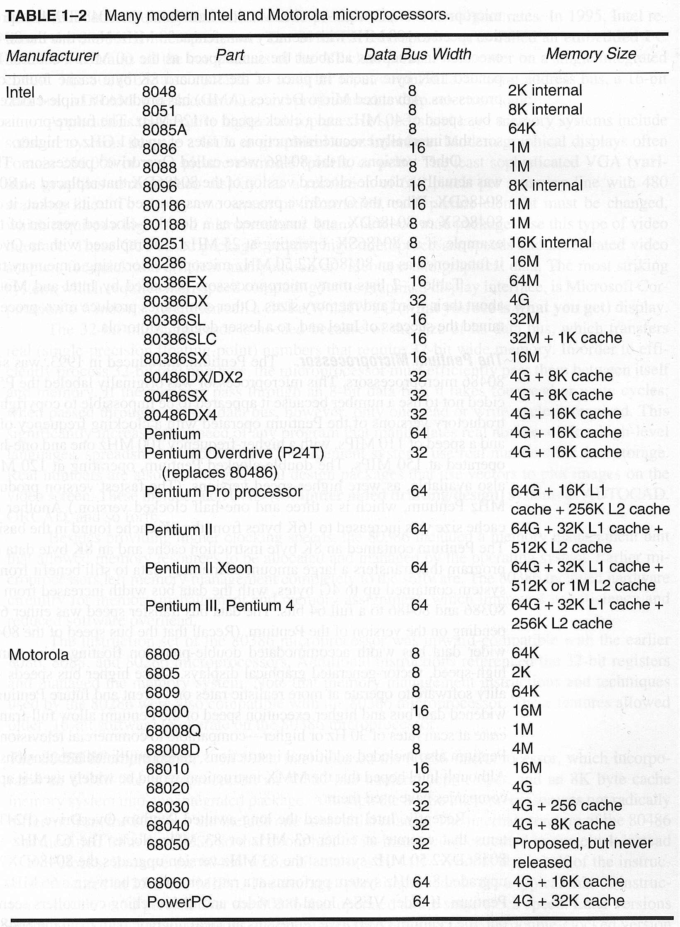
|
|
|
|
|
|

Slide 64
